Slide 1
Types of ANN
A Perceptron is the simplest form of an Artificial Neural Network (ANN) and serves as a foundational block for understanding more complex neural networks.

Slide 2
Defining the Perceptron:
Imports: Import necessary libraries like NumPy (for numerical computations) and matplotlib (for visualization).
Class definition: Define a class named Perceptron with the following attributes:
weights (W): A NumPy array containing the weights for each input feature and bias term.
learning_rate (eta): A float value between 0 and 1 that controls the update step size during training.
activation_function: The function used to activate the output based on the weighted sum of inputs. Common choices include the step function and the sigmoid function.

Slide 3
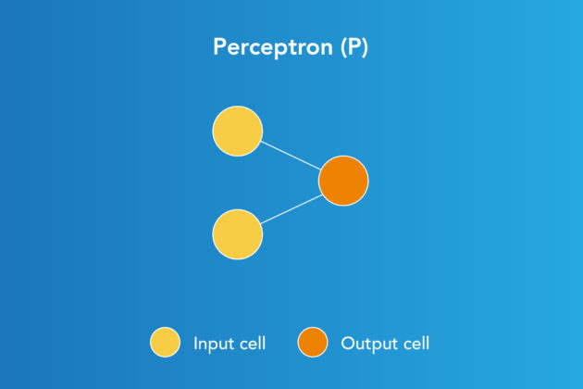
Perceptron model, proposed by Minsky-Papert is one of the simplest and oldest models of
Neuron.
It is the smallest unit of neural network that does certain computations to detect features
or business intelligence in the input data. It accepts weighted inputs, and apply the activation
function to obtain the output as the final result.
Perceptron is also known as TLU (threshold logic unit)

Slide 4
Building the Perceptron:
Constructor: Implement a constructor (__init__) that initializes the weights with random values and sets the learning rate.
Predict function: This function takes an input feature vector and returns the predicted output based on the weights and activation function.
Train function: This function takes the training data (inputs and labels) and iterates through the data, updating the weights based on the following steps:
Calculate the weighted sum of inputs.
Apply the activation function to get the predicted output.
Calculate the error between the predicted and actual output.
Update the weights using the learning rate and the error.

Slide 5
Activation functions play a crucial role in artificial neural networks (ANNs) by introducing non-linearity and allowing the model to learn complex relationships between input and output data. Here's an explanation and example of four common activation functions:
https://medium.com/mlearning-ai/introduction-to-perceptrons-building-your-first-neural-network-in-python-c7ae3616f2c1

Slide 6

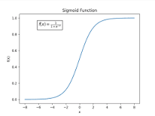
1. Sigmoid:
Equation: σ(x) = 1 / (1 + e^(-x))
Output range: (0, 1)
Properties: Smooth, continuous, monotonically increasing, differentiable.
Example: Predicting the probability of a customer purchasing a product.

Slide 7
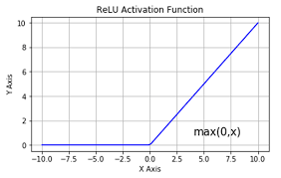
2. ReLU (Rectified Linear Unit):
Equation: f(x) = max(0, x)
Output range: [0, ∞)
Properties: Simple, computationally efficient, sparse output (many zeros).
Example: Image recognition, natural language processing.

Slide 8
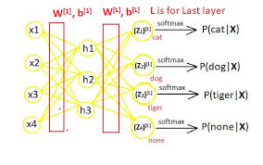
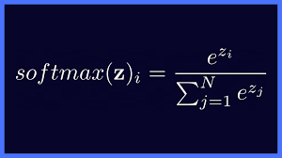
3. Softmax:
Equation: f_i(x) = e^(x_i) / Σ_j e^(x_j)
Output range: (0, 1)
Properties: Outputs sum to 1, suitable for multi-class classification.
Example: Classifying images into different categories.

Slide 9
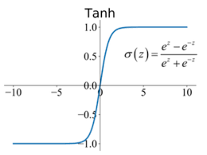
4. Tanh:
Equation: tanh(x) = (sinh(x)) / (cosh(x))
Output range: (-1, 1)
Properties: Zero-centered, smooth, continuous, differentiable.
Example: Language modeling, machine translation.

Slide 10
An example of how each function works with specific input values:
Input (x) | Sigmoid | ReLU | Softmax | Tanh
-2 | 0.1192 | 0 | 0.013 | -0.964
-1 | 0.2689 | 0 | 0.0498 | -0.7616
0 | 0.5 | 0 | 0.25 | 0
1 | 0.7311 | 1 | 0.5002 | 0.7616
2 | 0.8808 | 2 | 0.1872 | 0.964

Slide 11
Additionally, these functions can be combined in various ways within an ANN.
For example, ReLU is commonly used in hidden layers for its computational efficiency, while Softmax is often used in the output layer for multi-class classification tasks.

Slide 12
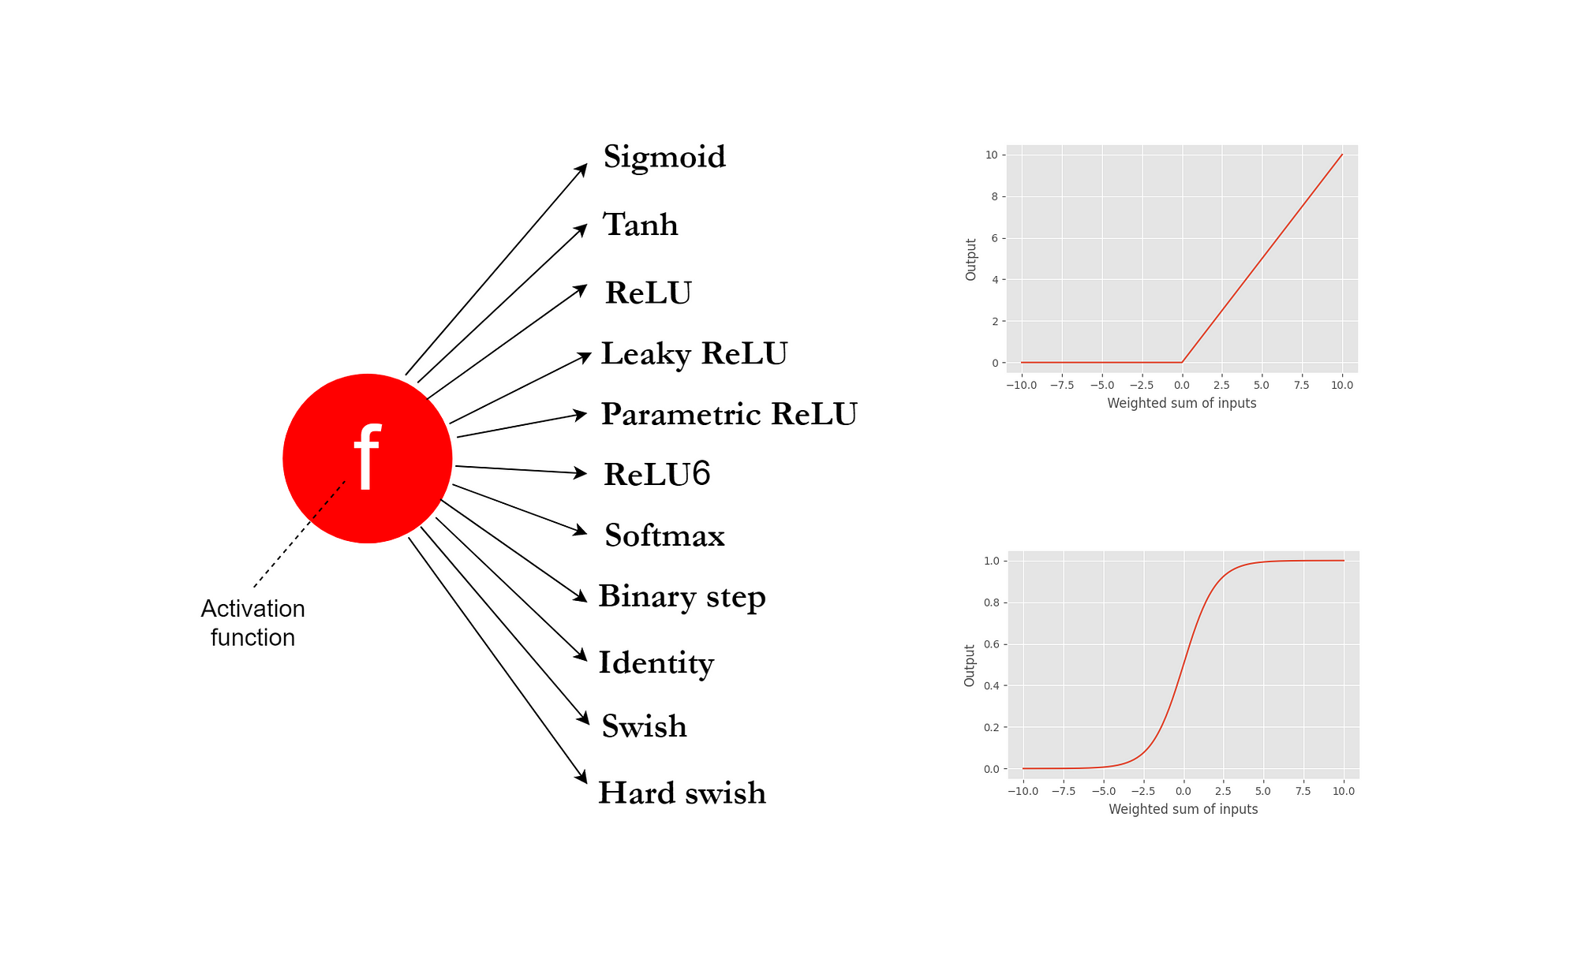

Slide 13
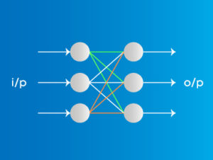
1. Feedforward:
In a feedforward network, information flows in one direction only, from the input layer through hidden layers to the output layer. Each neuron in a layer receives weighted inputs from the previous layer, performs an activation function, and sends its output to the next layer. This process continues until the output layer is reached.

Slide 14
Application of Feed Forward Network
Simple classification (where traditional Machine-learning based classification algorithms have limitations)
Face recognition [Simple straight forward image processing]
Computer vision [Where target classes are difficult to classify]
Speech Recognition

Slide 15
Feed Forward Network Pros and cons
Advantages of Feed Forward Neural Networks
Less complex, easy to design & maintain
Fast and speedy [One-way propagation]
Highly responsive to noisy data
Disadvantages of Feed Forward Neural Networks:
Cannot be used for deep learning [due to absence of dense layers and back propagation]

Slide 16
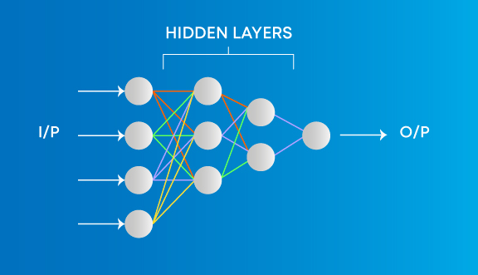
Applications on Multi-Layer Perceptron
Speech Recognition
Machine Translation
Complex Classification

